Slide 1
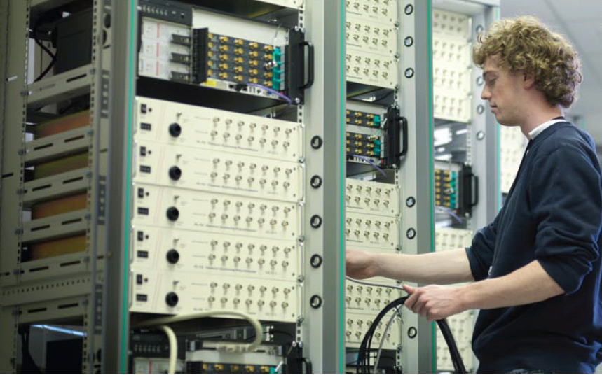
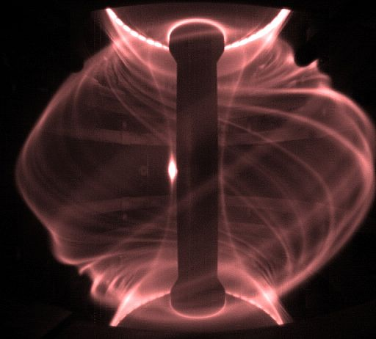
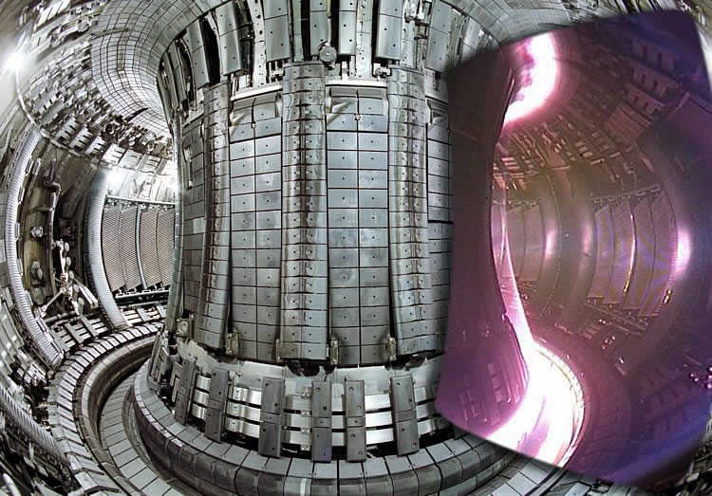
MCF Lab Kieran Gibson

Slide 2
MCF Lab
Practicalities:
lab book keeping etc. - ELOG
9am-5pm each day, but flexibility
Demonstrators: Bob Davies, Lucy Holland
Software:
Python
METIS

Slide 3
MCF Lab Timetable (schedule subject to change!)

Slide 4
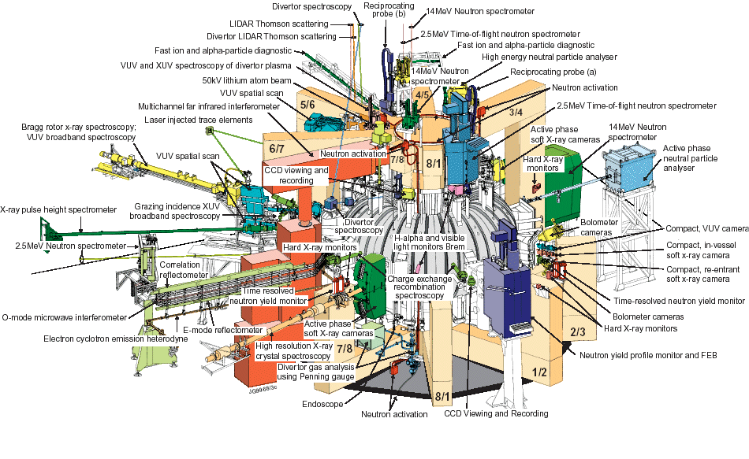
Diagnostic hardware can dominate an MCF experiment
laser
laser
laser
laser
Thousands of diagnostic data streams, digitised at fast rates: huge quantities of data to interpret
MCF lab will give “hands-on” experience using real tokamak data from MAST and use a tokamak “flight simulator” to explore physics of tokamak systems

Slide 5
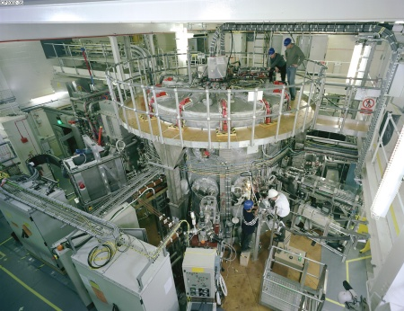
MAST Tokamak
laser
laser
laser
laser

Slide 6
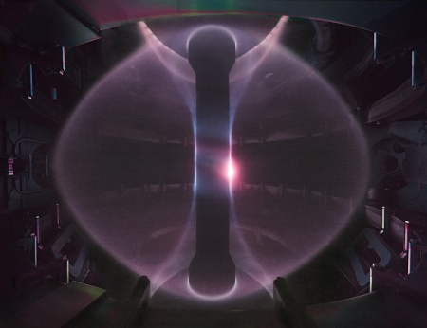
Diagnostic analysis - MAST Tokamak – in first two sessions
laser
laser
laser
laser

Slide 7
Physics analysis with METIS - JET Tokamak – final two weeks
laser
laser
laser
laser

Slide 8
MCF Lab Timetable (schedule subject to change!)

Slide 9
Thomson scattering (1)
Classical description is of incident wave accelerating an electron, which hence emits radiation (the scattered wave)
This classical description is only valid if incident photon energy is much less than rest mass energy of electron
Because of thermal motion of electrons the scattered signal will be Doppler shifted; spectrum of scattered light can be used to determine electron temperature

Slide 10
Thomson scattering (2)
A simple analysis based on dipole approximation allows the scattered field from a single electron to be calculated.
For incoherent scattering we arrange the scattering geometry such that Δkλ_{D} >>1
k_{i}
k_{s}
Δk =
k_{s} - k_{i}

Slide 11
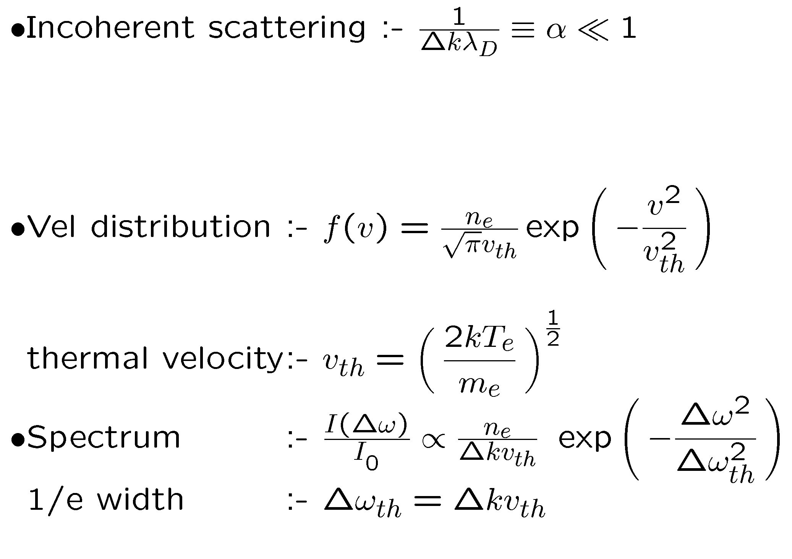
Thomson scattering (3)

Slide 12
Thomson scattering (4)
The challenge with Thomson Scattering systems lies essentially with the very small overall cross section for scattering meaning that typically only around 10⁻¹³ of scattered light is detected….hence the need for high powered lasers and careful optical design (to minimise stray light from entering the collection system

Slide 13
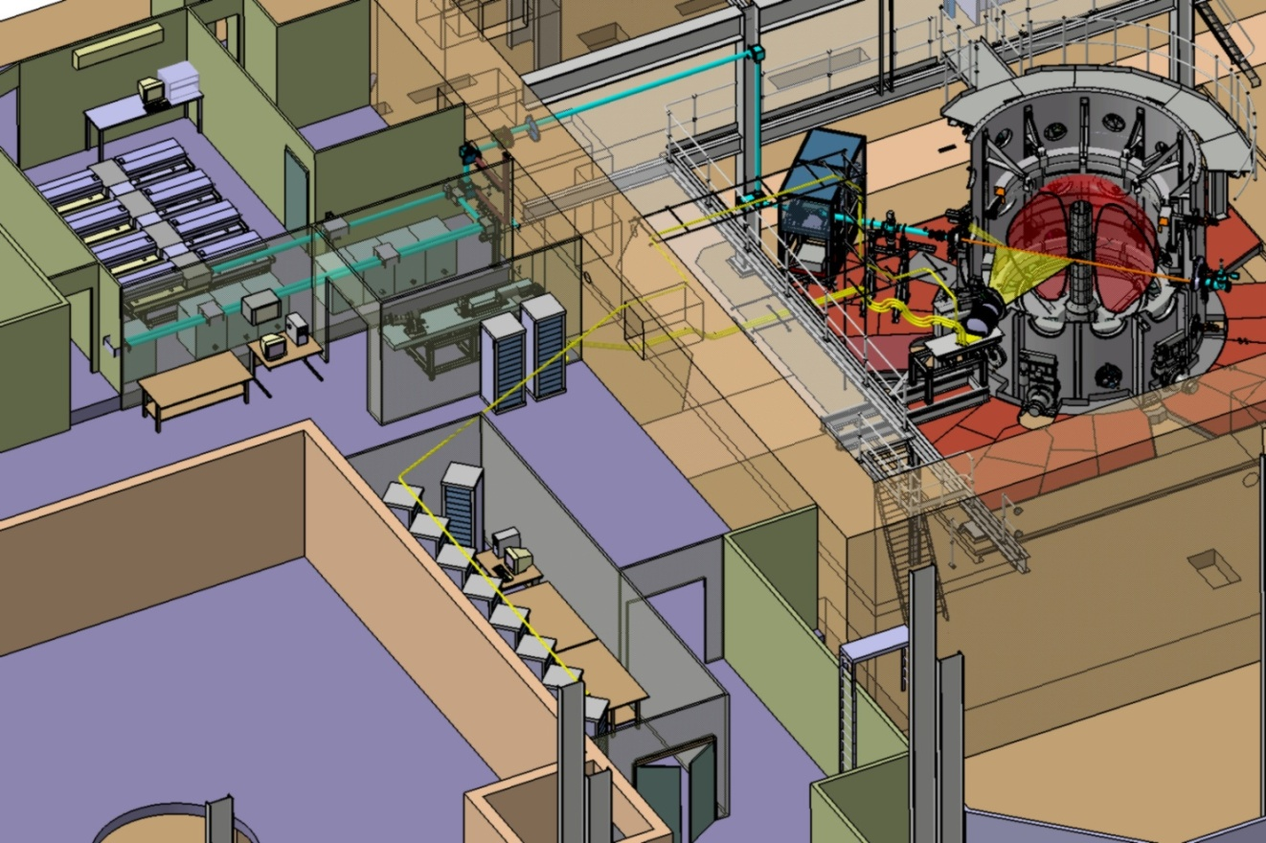
MAST Thomson scattering system upgrade
Thomson scattering in the MAST tokamak

Slide 14
MAST Thomson scattering system upgrade
Thomson scattering in the MAST tokamak

Slide 15
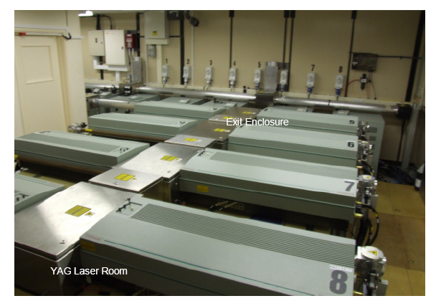
upgrade
Thomson scattering in the MAST tokamak

Slide 16
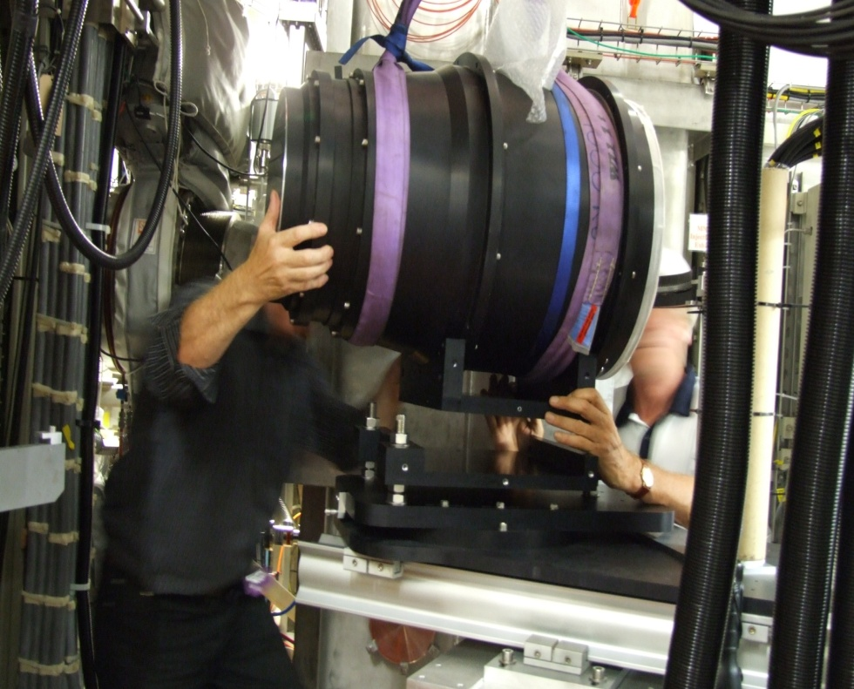
MAST Thomson scattering system upgrade
Thomson scattering in the MAST tokamak

Slide 17
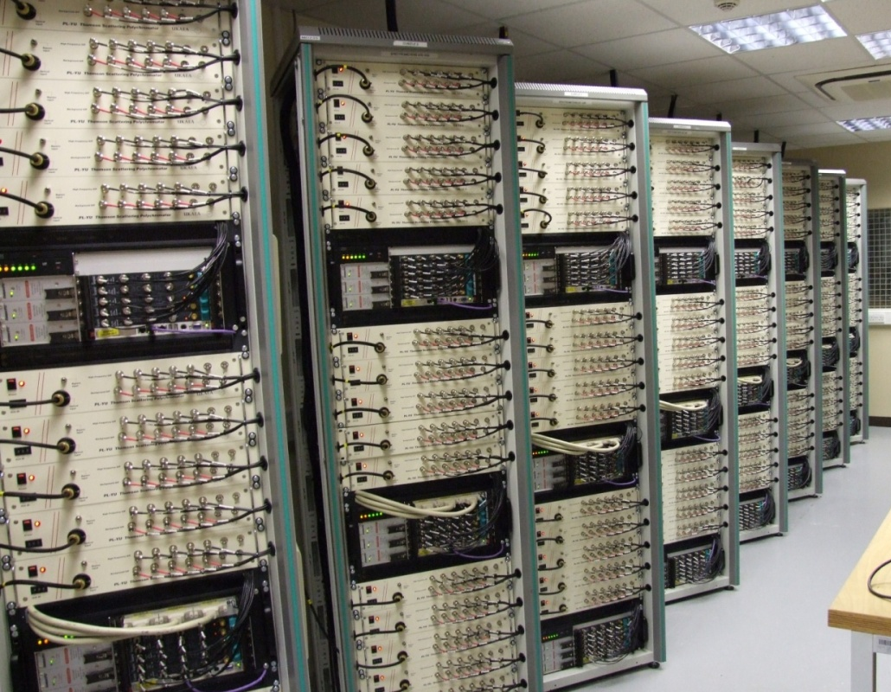
MAST Thomson scattering system upgrade
Thomson scattering in the MAST tokamak

Slide 18
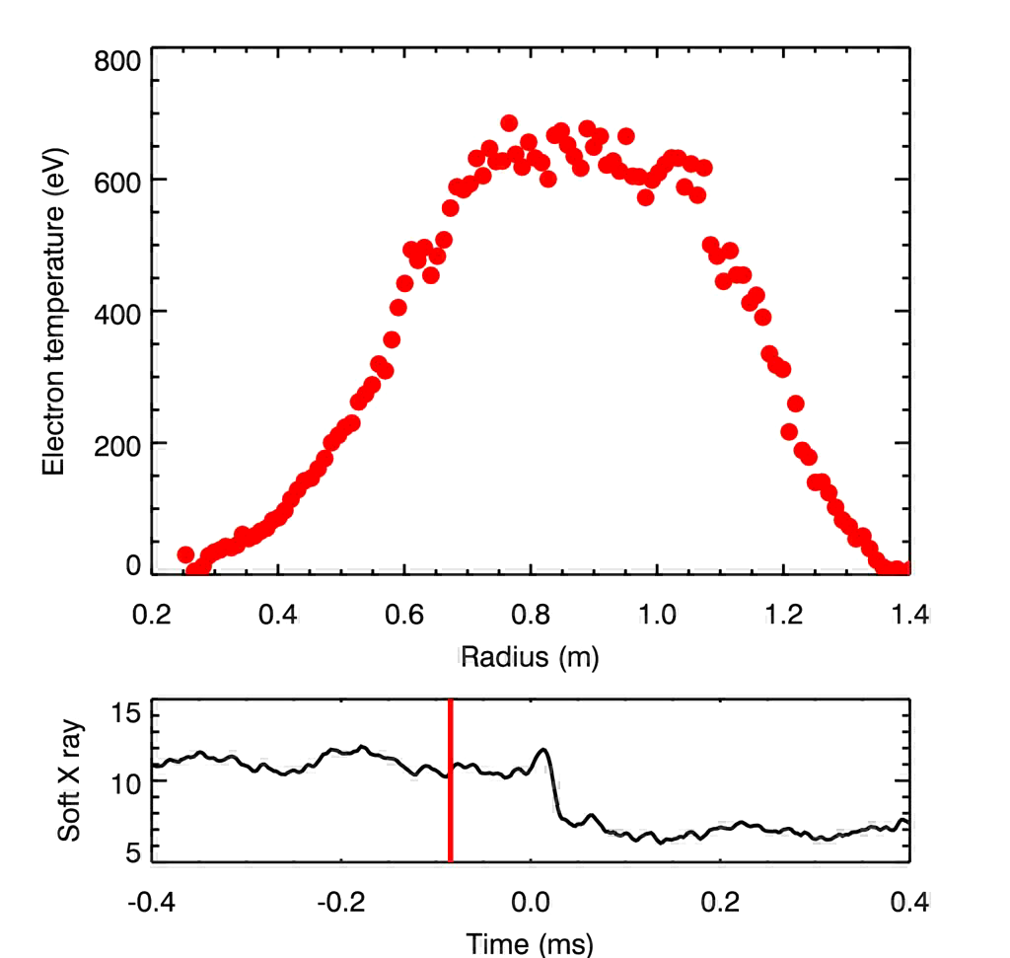
MAST TS examples: sawtooth crash
Thomson scattering in the MAST tokamak
MAST #24479
Example of sawtooth behaviour captured by burst mode laser operation (laser separation ~20μs)

Slide 19
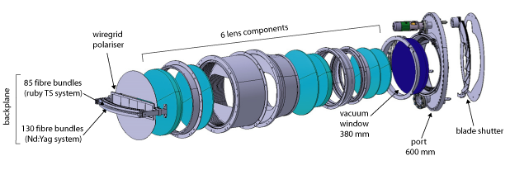
Collection lens & fibres: ruby spectrometer
Collection lens (both systems)
6 radiation-resistant lenses
F-number = F/6
large lens sizes to maximise light collection over the large major radius (1.4 m)
Fibres
Nd:YAG (130 fibre bundles)
each with130 sub-fibres of 230 µm diameter
randomly mapped
ruby (85 fibre bundles)
each with 243 sub-fibres of 230 µm diameter
coherently mapped to increase resolution
R. Scannell, M. J. Walsh RSI 79, 10E730 2008

Slide 20
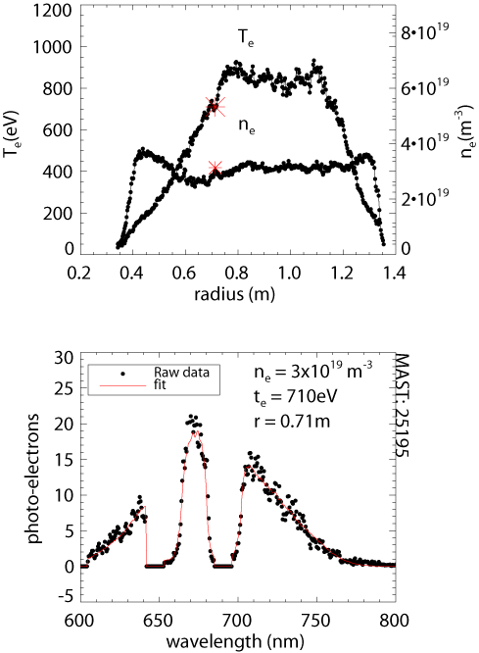
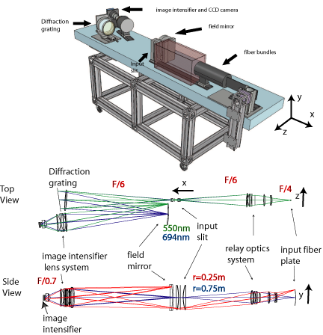
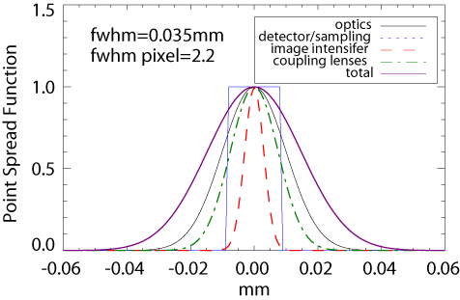
Ruby spectrometer
Parameter | Upgraded ruby | Original ruby | Nd:YAG
Resolution (mm) | 7 | 15 | 10
F/# | 15 | 15 | 6
EQE (%) | 18 | 6.7 | 18
Transmission (%) | 20 | 20 | 40
fdetected | 90 | 90 | 60
p.e.b (/cm/1019) | 3300 | 1100 | 2900
T O’Gorman and M. J. Walsh RSI 81, 123508 (2010)
Notes:
Future things
Resolution improve significantly with better coupling lenses
Fiber currently couple all the light to spectrometer .
Currently only single/double pulse detector can operate multi pulse issue laser

